Slide 1

Agenda
MIMIC - מה עושים עם הדאטה? נוסח הודעה
3 רעיונות שאולי ייתנו כיוון למוצר

Slide 2
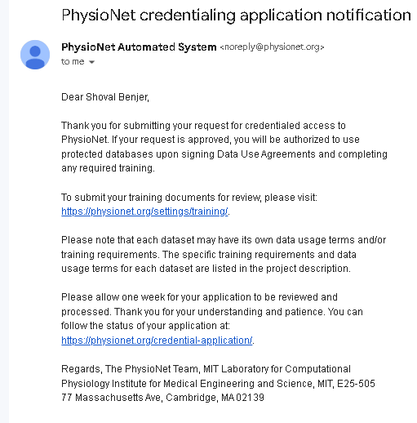
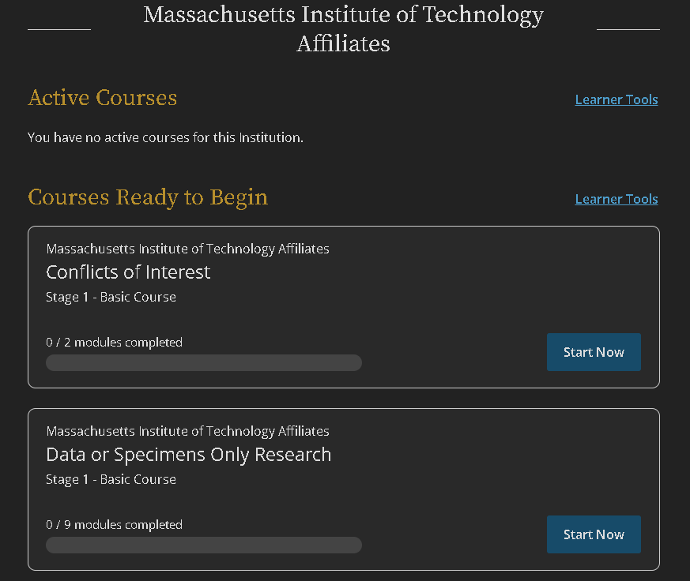
Mimic iv dataset progress

Slide 3
נוסח הודעה לאישור
שלום לכולם, אנחנו צוות מחקר מטעם עמותת BRAINSTORMIL במסגרת תכנית ALPHAWAVE, המתמקד בפיתוח פתרונות חדשניים להקלת כאבי פאנטום. נשמח לשמוע חוויות אישיות ותובנות ממי שחוו כאבים אלה בגפה קטועה ב-5–10 השנים האחרונות. השתתפותכם יכולה לתרום משמעותית לשיפור הטיפולים הקיימים. נשמח לתאם שיחה בטלפון או בזום אם זה מתאים לכם. תודה רבה, שובל – 0528034567, shovalb9@gmail.com

Slide 4
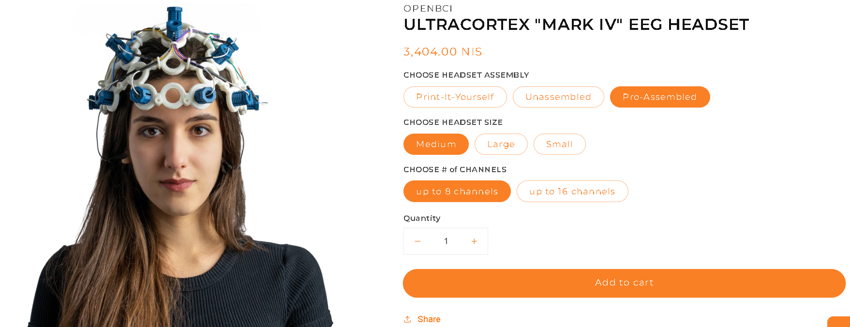
נוסח הודעה לאישור

Slide 5
Solution 1: Adaptive Neurofeedback and Haptic Feedback System
Technology: Use a neurofeedback platform that visualizes brain activity related to pain processing. Pair this with wearable haptic devices that deliver sensations matching real-time brain activity.
How It Works: Patients engage in neurofeedback training to reduce pain perception, while haptic devices provide sensory feedback to “trick” the brain into feeling the limb. The system learns and adjusts feedback patterns to optimize efficacy.
Innovation: Real-time adaptation using AI to tailor haptic feedback and neurofeedback training, reinforcing the brain’s natural pain modulation mechanisms.
Solution 2: Hybrid Mirror Therapy with Augmented Reality (AR)
Technology: Use AR glasses to enhance mirror therapy by projecting an augmented representation of the missing limb. Integrate this with EMG sensors to detect phantom limb muscle activity, providing visual and haptic feedback.
How It Works: Patients see and control a virtual limb, with muscle activity recorded and translated into corresponding movements and sensations. This multi-sensory approach engages visual, proprioceptive, and haptic systems simultaneously.
Innovation: Combines traditional mirror therapy principles with immersive AR and muscle feedback, potentially increasing neuroplasticity and pain relief duration.

Slide 6
Solution 3: Personalized Non-Invasive Brain Stimulation
Technology: Use EEG to monitor brain activity associated with pain. Apply non-invasive brain stimulation (like tDCS) in targeted brain areas, adjusting stimulation patterns based on real-time EEG data.
How It Works: A closed-loop system where brain stimulation is tailored to the individual’s neural pain signature, promoting long-lasting brain reorganization and pain reduction.
Innovation: A smart, adaptable system that continuously learns and refines treatment, improving efficacy over time.

Slide 7
Step 5: Research Existing Solutions and Identify Collaboration Opportunities
Review Current Methods: Analyze the efficacy of existing therapies like mirror therapy, VR applications, and neuromodulation techniques.
Collaboration Ideas:
Interdisciplinary Teams: Work with engineers, neuroscientists, and pain management specialists.
Tech Companies: Collaborate with firms specializing in wearables or AR/VR technology for development support.
Step 4: Address Implementation Challenges
Technological Feasibility:
Use off-the-shelf components where possible (e.g., AR glasses, wearable haptics) to prototype quickly.
Collaborate with neuroscience researchers to fine-tune neurofeedback and brain stimulation methods.
Clinical Validation:
Start with small-scale clinical trials to test safety and effectiveness.
Use wearable EEG and haptic devices to collect extensive data for model improvement and personalization.
User Experience:
Ensure the devices are comfortable, non-intrusive, and easy to use daily.
Offer gamified neurofeedback exercises to keep patients engaged and motivated.

Slide 8
Step 6: Evaluate and Refine the Proposed Solutions
Gather feedback from medical professionals and patients to understand practical challenges.
Use iterative prototyping and testing to refine the technology, focusing on both effectiveness and patient comfort.
Step 7: Potential for Future Expansion
If successful, expand the technology to other types of chronic pain management.
Explore integrating AI-driven analytics to continuously learn and optimize treatment for each user.
Would you like to explore any of these solutions in more depth or discuss another direction?

Slide 9


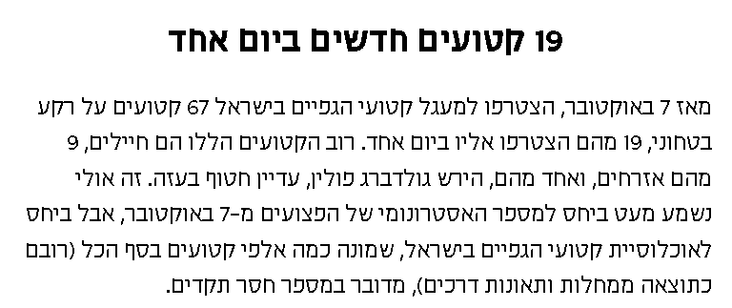
Purchasing a private prosthesis abroad, particularly in the U.S., involves very high costs to the individual patient - ranging from tens to hundreds of thousands of dollars for each indiviual, depending on the type of amputation. Additional costs include flights, accommodation, training, and rehabilitation, often abroad.
In Israel, for those purchasing a prosthesis through the Ministry of Health (in cases of illness or accident, not for military or terror-related injuries), a co-payment of up to 25% of the cost is required, based on socioeconomic status.

Slide 10
Phantom Pain Profile
Crushing Toes Twisting Hot iron Burning Cramping
Tends to localize to more distal phantom structures (e.g. fingers and toes)
Prevalence in early stages 60-80%
Independent of age in adults, gender, level or side of amputation
Phantom Sensation
Individuals with amputation may also experience phantom sensation, which is different from PLP. Phantom sensation is almost universal and doesn't correlate with pain reports.
There are three types of phantom sensations: Kinetic (movement) Kinesthetic (size, shape, position) Exteroceptive (touch, pressure, temperature, itch, vibration).
Phantom Limb Pain (PLP) Overview
Phantom limb pain (PLP) is a real sensation felt in a limb that has been amputated. It can range from mild to severe and manifest as burning, itching, or throbbing.
Phantom limb pain (PLP) affects 40%-80% of amputees and presents a challenge due to its complex cortical, spinal, and peripheral mechanisms.
The U.S. has an estimated 2 million major limb amputees, with projections to reach 3.6 million by 2050, underscoring the importance of addressing PLP complications.
סל רגשי של טריגרים, גובה הפגיעה, גובה הקטיעה, תמיכה סוציאלית, נראות הקטיעה, האזור הקטוע, מרכיב אישיותי, PAIN ACCEPTANCE, READINESS TO CHANGE
Fatigue anxiety stress Depression Infection Blod flow issues

Slide 11
Mirror Therapy
Prosthetics with Sensory Feedback
VR/AR Therapy
Pharmacological/Surgical Involvement
Treatment Challenges and Approaches
Current treatments for phantom limb pain include mirror therapy, medications, and neurostimulation. However, long-term efficacy and full integration with the body’s sensory systems remain challenging.
We Should addresses these challenges by aiming for more holistic and long-term solutions.
The heterogeneous pathology of PLP makes it difficult to provide effective treatments.
Pharmacological interventions have been and continue to be regularly employed, but their efficacy remains uncertain due to limited supporting evidence.
long-term efficacy and full integration with the body’s sensory systems remain challenging.
Current treatments for phantom limb pain include mirror therapy, medications, and neurostimulation.

Slide 12
Emerging Solutions and Need for Further Research
Neurofeedback Approach
Model Design
More randomized controlled trials are needed to assess long-term efficacy, compare treatment impacts, and identify the most effective methods for different patient populations.
A majority of literature advocates for evaluating alternative methods to address the diverse causes of PLP.
Novel surgical management methods are favored in current research, but further exploration of other treatments is essential for patient-centered care.
Integration of Sensory Systems: How can we develop technologies that better simulate the complex feedback loop between the brain and the body
Integration of Sensory Systems: How can we develop technologies that better simulate the complex feedback loop between the brain and the body
transcranial direct current stimulation (tDCS)sensorimotor cortex This non-invasive brain stimulation is combined with phantom limb movements to directly target neural circuits tied to pain processing.
Methodology: The study was a double-blind, sham-controlled design. Participants performed phantom hand movements during the stimulation. Functional neuroimaging (fMRI) was used to assess brain activity before, during, and after stimulation.
Downregulation of activity in the sensorimotor cortex (missing hand area) was strongly linked to PLP relief. Increased recruitment of the mid and posterior insula during stimulation predicted greater pain reduction. These brain regions play a key role in modulating pain. Findings suggest these mechanisms can be harnessed for longer-term relief. Potential for personalized neurofeedback and brain stimulation treatments for PLP and related neuropathic pain conditions.
Neurofeedback involves monitoring brain activity and providing real-time feedback, enabling individuals to modulate their neural patterns. EEG captures electrical activity in the brain but is complex.
That’s why we Should Transform EEG data into a frequency domain to reveal hidden patterns using Wavelet Transform Techniques
Approach: Feature Extraction: Identify frequency bands (e.g., alpha, beta waves) linked to pain. Model Development: Use algorithms like Recurrent Neural Networks (RNNs) or Long Short-Term Memory (LSTM) networks to model temporal dependencies. Training: Train models on labeled data (pain vs. no pain states with time series split). Real-Time Analysis: Implement models that can process data in real-time for immediate feedback.

Slide 13
Competitors in Israel
Competitors Globally
BrainMARC: An Israeli company specializing in neurofeedback solutions for various neurological conditions, though specific applications to PLP are not widely reported.
Neuromedical Group: Offers neurofeedback and EEG-based treatments, potentially adaptable for PLP.
MindMaze: A Swiss company that developed "MindMotion," a virtual reality neurofeedback system for stroke rehabilitation, which could be adapted for PLP.
Neurotherapy Solutions ltd: Provides neurofeedback therapy for chronic pain management in the U.S.
MyndPlay: UK-based company offering EEG-driven neurofeedback platforms, mainly for cognitive training but with potential applications in pain management.

Slide 14
References
Discussion on the benefits of converting EEG signals to spectrograms for neurofeedback applications.
Possible Dataset of mimic iv (Published October 11 2024)
Mimic iv extraction tutorial on Googlecolab
PLP Neurofeedback idea Article

Slide 15
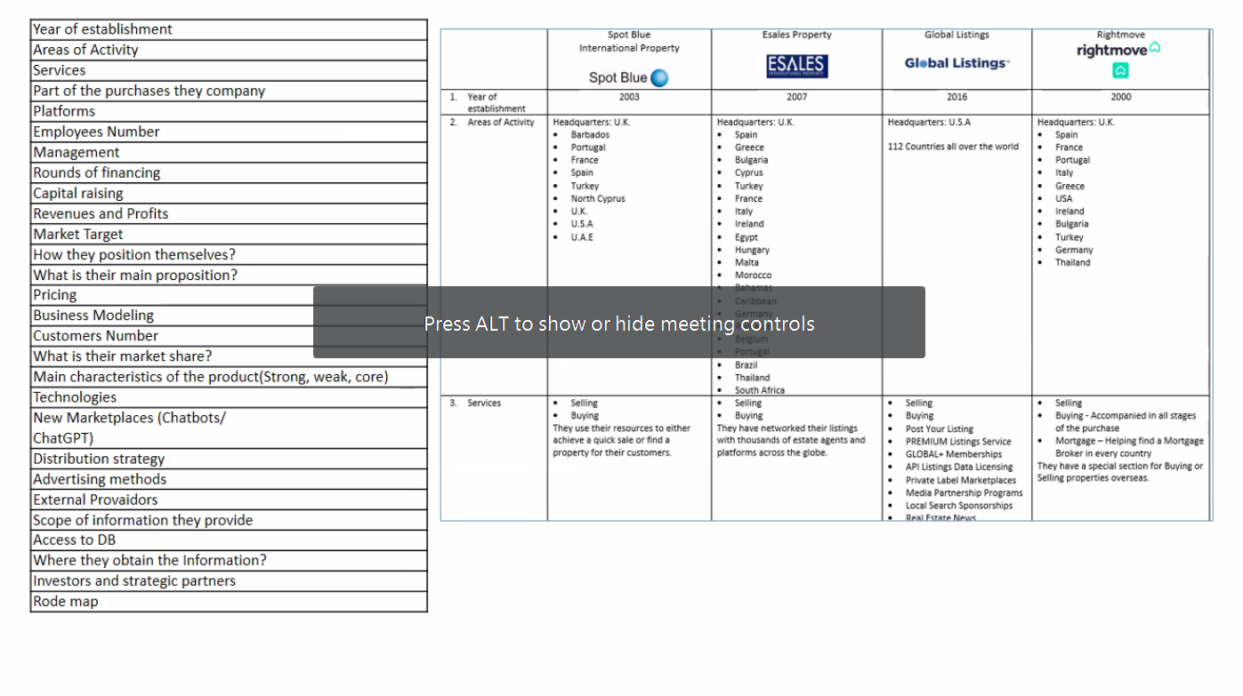
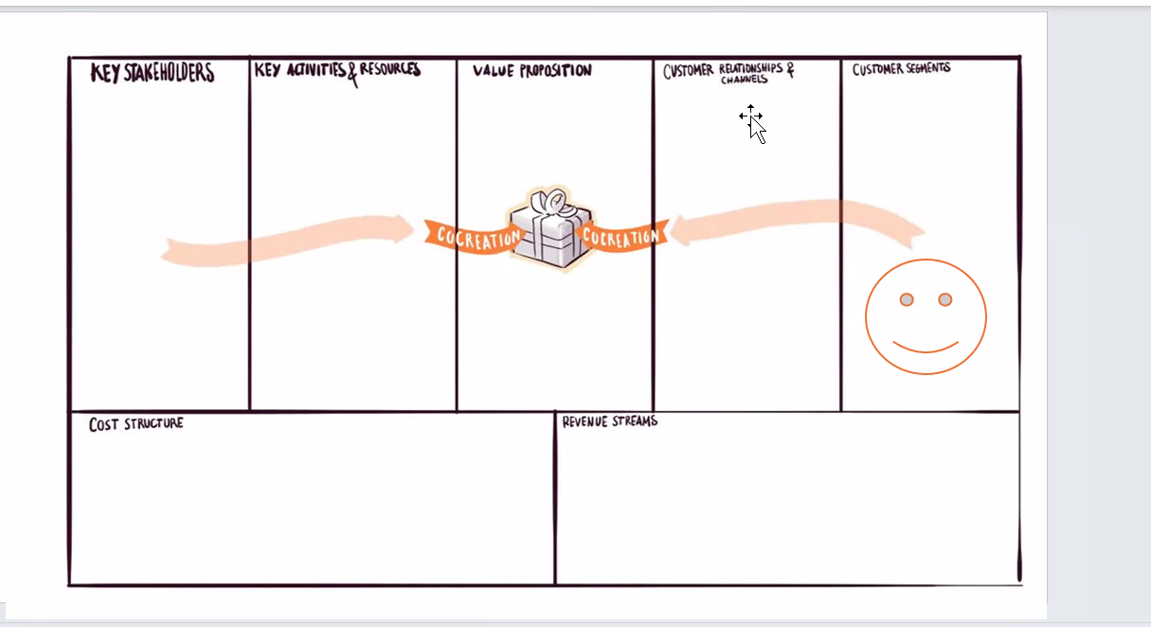
References:

